Slide 1
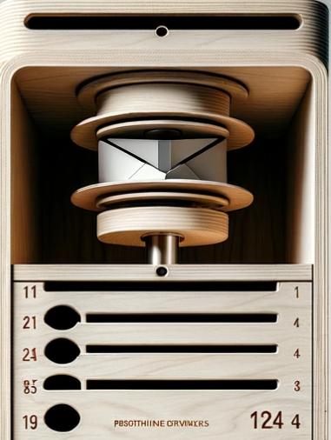
Smart Mailbox Sorter: Automated Residential Mail Management System (SSM-ARMS)
Submitted by: Groupe n°2
Aya Chatiou
Mayssa Tebourbi
Nujhat Fatima
Sultan Oloyede
Gbegbe Decaho
Esdras Sumaili
Submitted to Professor: Dan Ionescu

Slide 2
Project Description
An automated mail sorting system designed to streamline letter distribution for apartment complexes.
Uses a conveyor belt to transport letters.
Controlled by Raspberry Pi for precise movement.
Integrates camera with AI for accurate letter identification.
Linear actuator positions the belt for correct compartment alignment.
Includes a mobile app for residents to interact with the system.
Notes:
Problem Statement :
Apartment mail management frequently faces challenges like delivery errors and mail theft, leading to privacy concerns and inefficiency. Additionally, residents often struggle with insecure and inconvenient mail sending options, causing delays and further disruptions.
The Essential Solution - SSM-ARMS :
SSM-ARMS, with its two independent boxes, streamlines apartment mail handling by securely sorting incoming letters into individual compartments and facilitating outgoing mail for various services. More than just convenient, it's an essential tool for efficient, modern mail management, ensuring organized and hassle-free distribution.
Future Perspective :
Initially for letter management, SSM-ARMS is adaptable for future package management needs in apartment buildings.

Slide 3
Our goal for this semester
Enhance AI accuracy for letter reading.
Implement motor control for conveyor belt rotation.
Integrate linear actuator for conveyor belt alignment.
Develop web application with database for resident management.
Finalize the prototype of the mailbox
Notes:
Problem Statement :
Apartment mail management frequently faces challenges like delivery errors and mail theft, leading to privacy concerns and inefficiency. Additionally, residents often struggle with insecure and inconvenient mail sending options, causing delays and further disruptions.
The Essential Solution - SSM-ARMS :
SSM-ARMS, with its two independent boxes, streamlines apartment mail handling by securely sorting incoming letters into individual compartments and facilitating outgoing mail for various services. More than just convenient, it's an essential tool for efficient, modern mail management, ensuring organized and hassle-free distribution.
Future Perspective :
Initially for letter management, SSM-ARMS is adaptable for future package management needs in apartment buildings.

Slide 4
Project Architecture
Requirements satisfied in this semester
Functional requirements
Non-Functional requirements
Mail Handling via Conveyor Belt : The conveyor belts sort mails to the correct apartment
Mail Sorting Mechanism: Recognize the address of the recipient to determine the corresponding box.
Delivery Process: Once the appropriate level is reached, the internal servo motor turns and the conveyor belt pushes the mail into the mailbox of the designated apartment.
Mailbox Reset : After delivery, the conveyor system resets its position to the default state for processing the next piece of mail
Address Readability: The AI model identifies the apartment number from the address written on the letterhead.
Scalability: Adaptable to different sizes.
Energy Efficiency : The system optimizes power usage, particularly for the conveyor belts and actuators.
Security : The mailbox compartments are secure, preventing unauthorized access.
Integration: The system integrates seamlessly with the Raspberry Pi as well as other hardware components.
Notes:
Functional requirements
Letter Detection and Verification:Ability to detect the letter’s presence, recognize the address of the receptor and determine the concerned box.
Engine sorting algorithm: Direct the letter to the box linked to it and throw it there.
Trap Door: Send signal to allow next letter to be dropped.
Notification and Communication: Alerts must be sent to recipient of letter upon letter is detected by camera.
Wireless Communication: Maintain constant connection with the central system for reception and dispatch.
Non-Functional requirements
Reliability: Consistent operation with minimal errors or downtime.
Performance: System must be smooth and timely when detecting letters and authenticating/interacting with users.
Scalability: Adaptable to different sizes.
Readability: System should be user friendly and provide fail-safe mechanism.
Maintainability: Easy to identify gaps for system improvements, troubleshoot procedures and smooth maintenance .

Slide 5

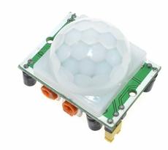
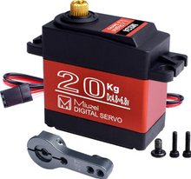
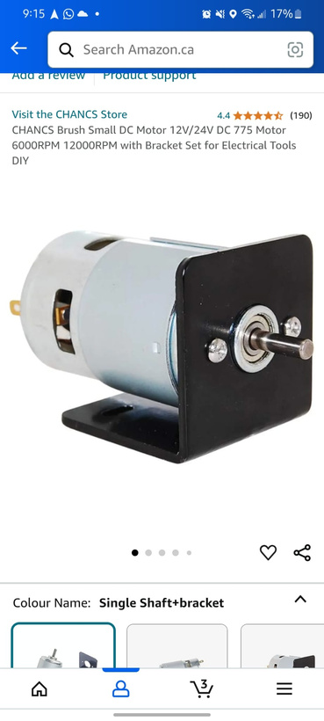
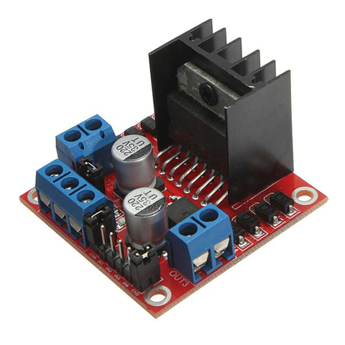
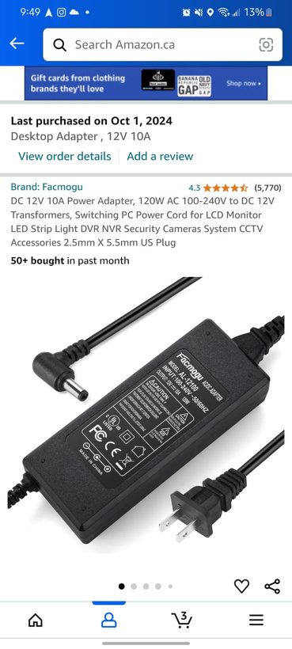
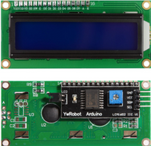
Update in Hardware Components
Item identification webcam:
Logitech C270
Automated Transport Motor
Proximity Sensor:
HC-SR501 based on infrared technology, high sensitivity, high reliability, ultra-low-voltage operating mode
The servomotor:
Miuzei Servomoteur numérique à couple élevé 20 kg Servo en métal étanche pour robot de voiture R/C, angle de contrôle DS3218 270°
Moteur DC 775, tension 12V/24V, vitesse 6000 RPM à 12V et 12000 RPM à 24V, couple élevé, faible bruit, support inclus pour montage facile.
L298N Motor Driver Module
12V 10A Power Adapter for Motor Power Supply
DC 775 motor, 12V/24V, 6000/12000 RPM, high torque, low noise, includes mounting bracket.
Powers 12V DC motors and linear actuator, stable 12V output at 10A, ensures reliable motor operation, compatible with L298N driver.
LCD screen :
LCD1602 Screen with Backlight LCD Display Module Board 2 x 16 Characters 1602 5v for Ar-duino Duemilanove Robot 1602A UNO R3 MEG

Slide 6
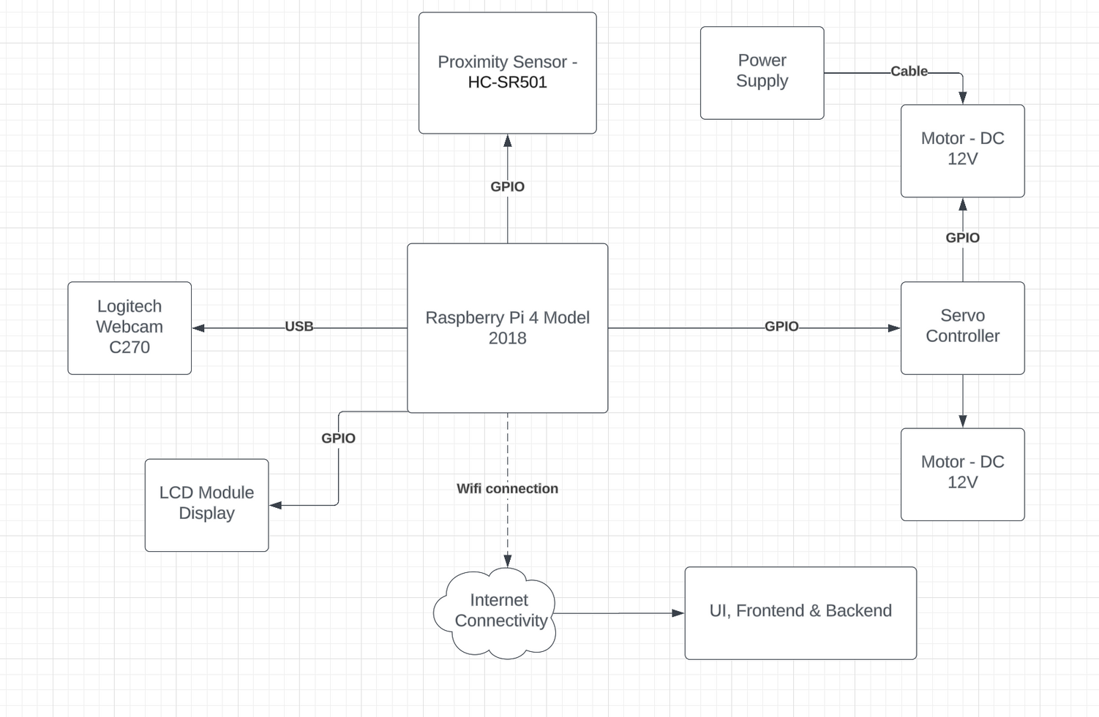
Hardware Architecture

Slide 7




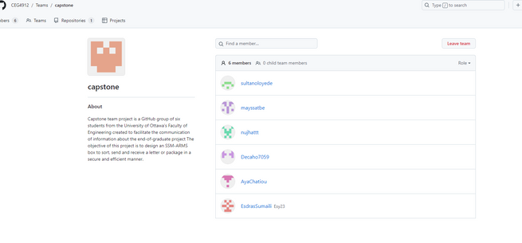

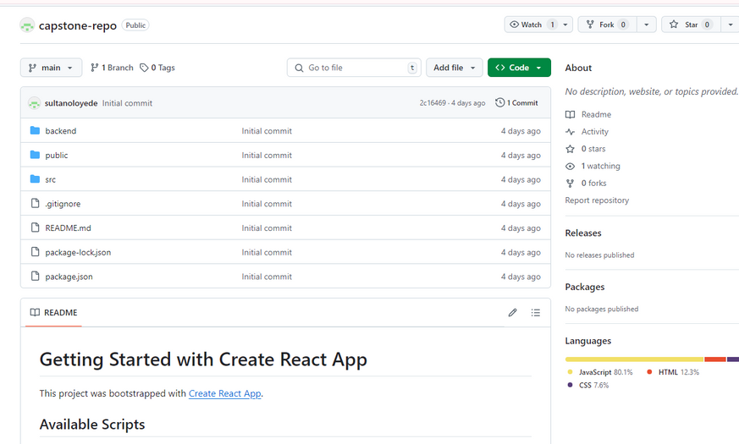

Software Architecture
Motor Control Library (RPi.GPIO)
Message Display Library (RPLCD)
Image recognition OpenCV, Tensorflow
ML training with MNIST dataset
Web application made with Python using Flutter
MongoDB Configuration
Firebase for push notifications
Manages the mail database, storing resident addresses and corresponding email addresses.

Slide 8
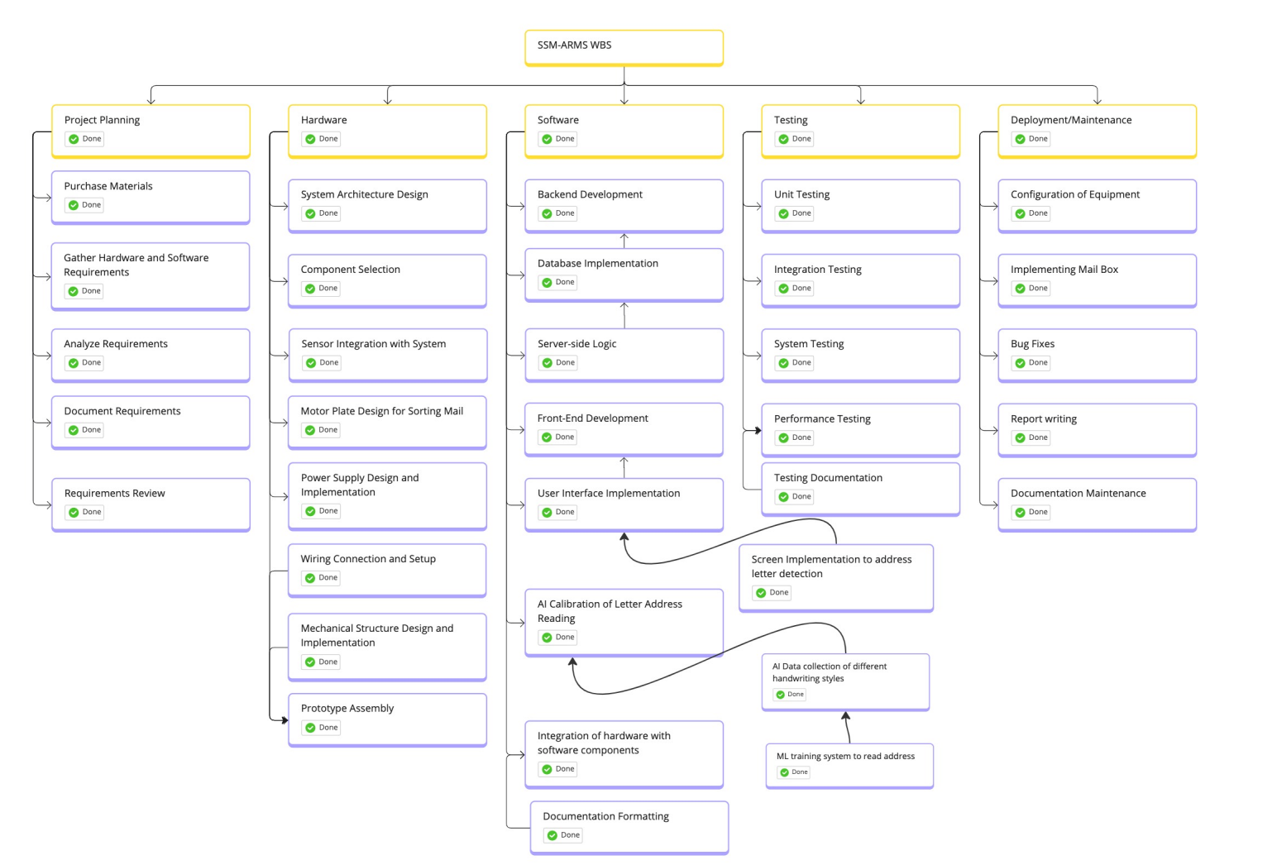
WBS

Slide 9
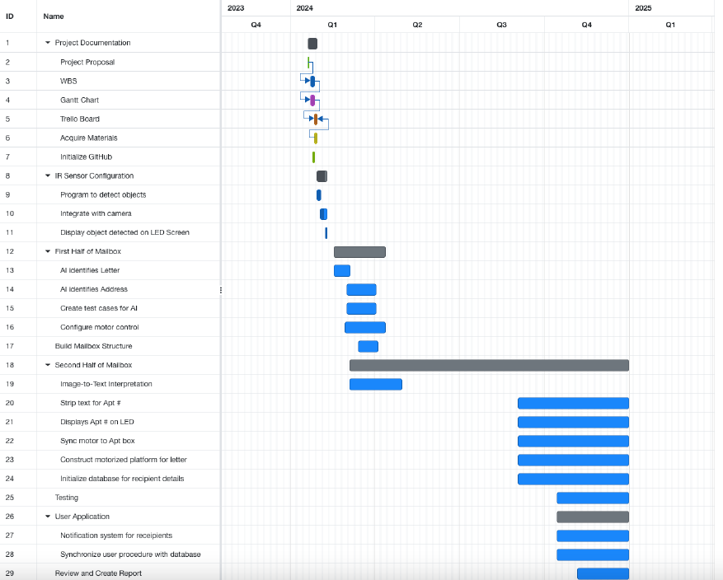
Gantt Chart

Slide 10
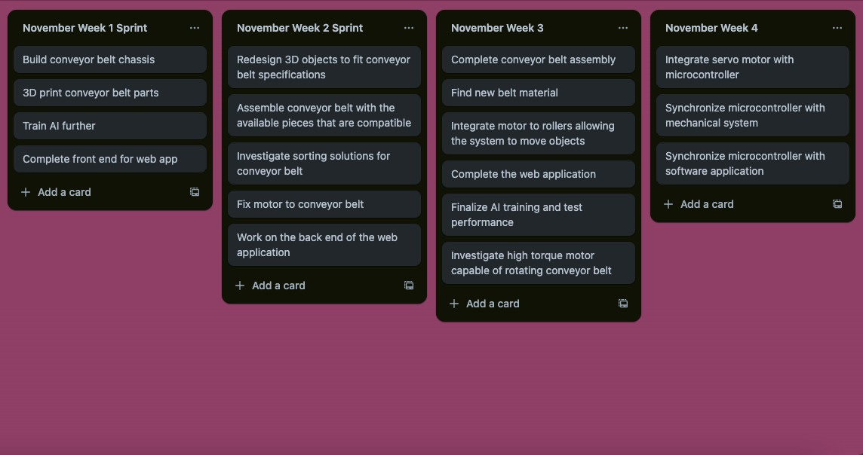
Management using Trello

Slide 11
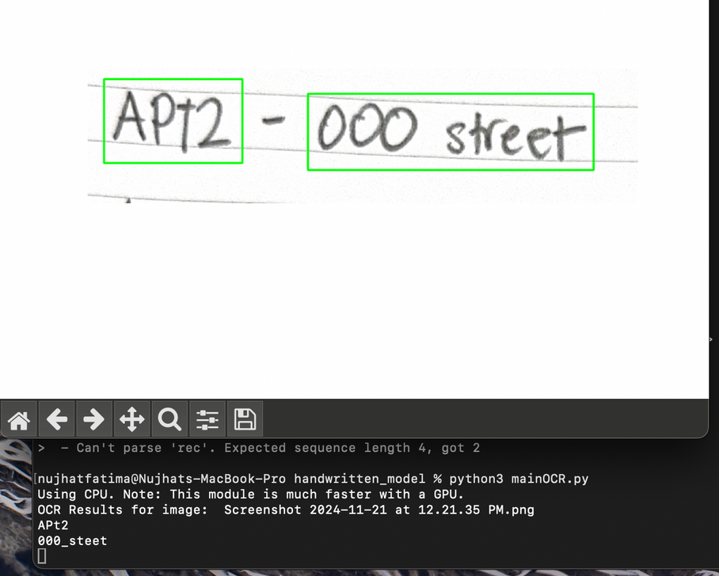
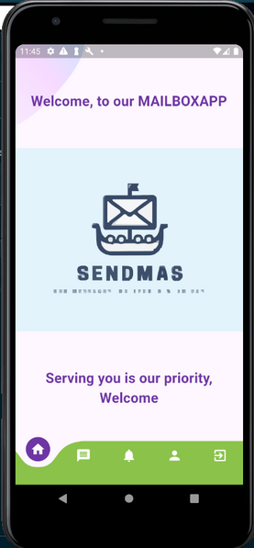
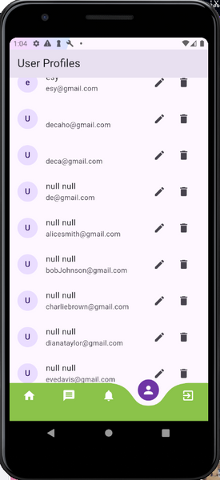
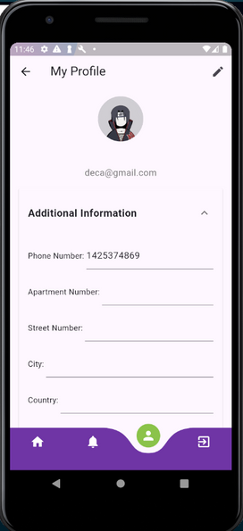
Implemented/ in work modules
AI reading of digital handwritten digit recognition with around 80% accuracy
Web Application
Progress
As a admin
as a user

Slide 12
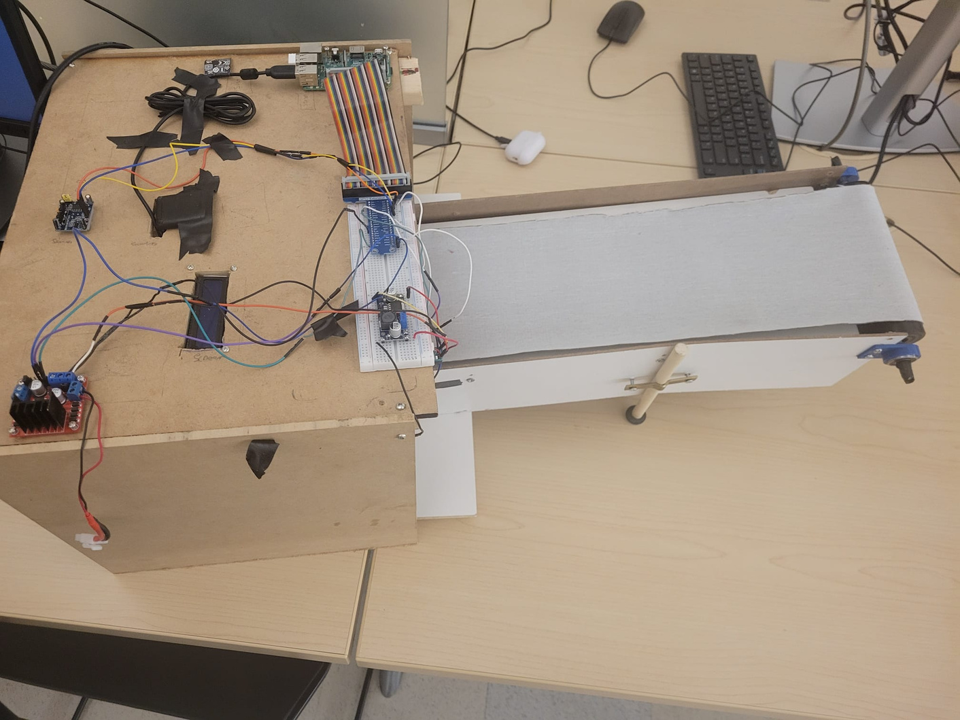
Implemented/ in work modules

Slide 13
HW and SW Distribution per team member
Mayssa
Sultan
Esdras
Conveyor Belt (Panels)
Materials acquisition (3D Printing)
Software (Database management )
Push notification with Firebase
Project coordinator
Conveyor Belt
Linear accurator implementation
box assembly
Nujhat
Decaho
Aya
Software (AI Implementation)
Hardware (camera maintenance & synchronization)
Software (database management, implement the web application)
Hardware integration (support)
Hardware Specialist
System Integration Specialist

Slide 14
Thanks for
your attention

